Slide 1


COMPARE Trial: Cold Oxygenated Machine Preservation of Aged Renal DCD engraftments
Ina Jochmans
Jacques Pirenne

Slide 2

Project Outline

Slide 3
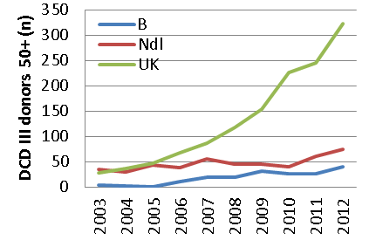
Project outline
Rational
Increasing organ shortage -> use of suboptimal donor organs
Extended criteria donors (ECD)
Deceased after cardiac death (DCD)

Slide 4
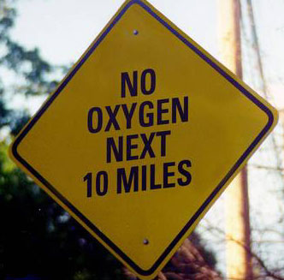
Project outline
Rational
HMP of DCD III kidneys decreases DGF, but
No improvement in kidney function
No improvement in graft survival
And older DCD donor (> 60 % 50+) with
Reduced kidney function
Reduced graft survival
HMP currently without O2
Experimental studies:
Benefit of + O2
No clinical studies comparing HMP vs HMP-O2

Slide 5
Project outline
Objective
HMP vs HMP+O2 in 50+ DCD III kidneys
1st EP: 24 h creatinine clearance @ 1 year (mGFR)
2nd EP:
DGF
Functional DGF
PNF
GS and PS@ 1 year
eGFR @ 3 mo, 6 mo and 1y
AR-Bx
Length hospital stay
3rdEP:
Health-economics
Notes:
Functional DGF defined as the absence of a decrease in the serum creatinine level of at least 10% per day for at least 3 consecutive days in the first week after transplantation, not including patients in whom acute rejection or calcineurin inhibitor toxicity is proven on biopsy.²⁹

Slide 6
Project Outline
Inclusion / Exclusion criteria
Donors
Inclusion criteria:
≥ 50y
DCD III
2 different recipients
2 kidneys transplantable
Recipients
Inclusion criteria:
≥ 18
end-stage renal failure
active waiting list
Exclusion criteria:
combined Tx
planned dual Tx

Slide 7
Sample size
Project Outline
8 mL/min difference in mGFR @ 1 year
83 pairs to be analysed
Screening of 194 donors
Realistic inclusion 10 pairs/mo - 18 month inclusion
Randomisation - Paired
Both kidneys on the back table & transplantable
Randomisation by Transplant Technicians
If kidneys can’t be connected to the machine – still inclusion as intention-to-treat analysis

Slide 8
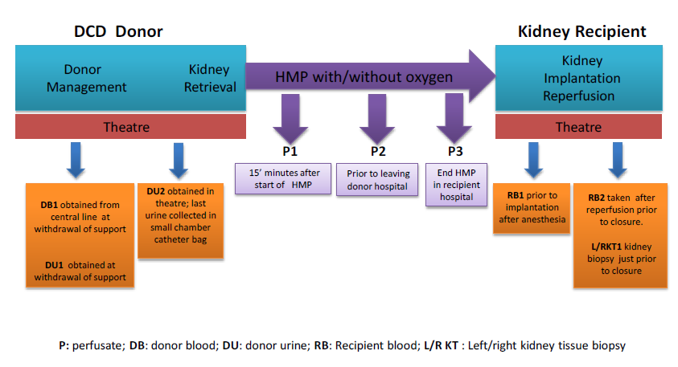
Project outline
Samples

Slide 9
Project outline
Follow up
Activity | Pre -Tx | Postoperative |  |  |  |  |  |  | Follow up
 |  | D1 | D2 | D3 | D4 | D5 | D6 | D7 | M3 | M6 | M12
Dialysis requirement |  | X | X | X | X | X | X | X | X | X | X
Graft survival |  | X | X | X | X | X | X | X | X | X | X
Recipient survival |  | X | X | X | X | X | X | X | X | X | X
Serum Creatinine |  | X | X | X | X | X | X | X | X | X | X
24-h creatinine clearance |  |  |  |  |  |  |  |  |  |  | X
Quality of Life (EQ-5D) | X |  |  |  |  |  |  |  | X |  | X
Data will be registered in a computer program (eCRF)

Slide 10

Project outline
Who?
Logistical partner: Med-Assist
-> Transplant technicians
Transplant Coordinators
Nephrologists
Surgeons
When?
Start: October 2014
Where?
All transplant centres in:
Belgium
The Netherlands
Oxford region - UK

Slide 11
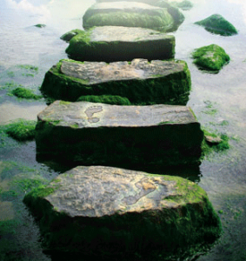
Step by Step Guide

Slide 12
Step by Step procedure
Donor
Transplant Coordinator (TC) informs Transplant Technician when donor is reported
This patient meets the inclusion criteria of
the COMPARE study.
Please notify the transplant technician.
Tel. 0031 1 23 45 67
TC plans procurement and communicates with donor hospital, procurement team & transplant technician
Procurement team
Med-Assist: logistical partner
All donor logistics for the trial
Transplant Technician

Slide 13
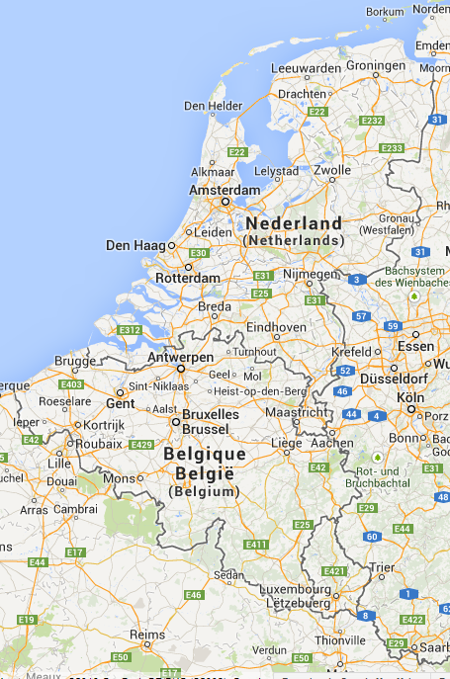
Med-Assist - Transplant Technicians
2 Hubs for logistics:
Groningen: North of the Netherlands
Maastricht: Belgium & south of the Netherlands

Slide 14
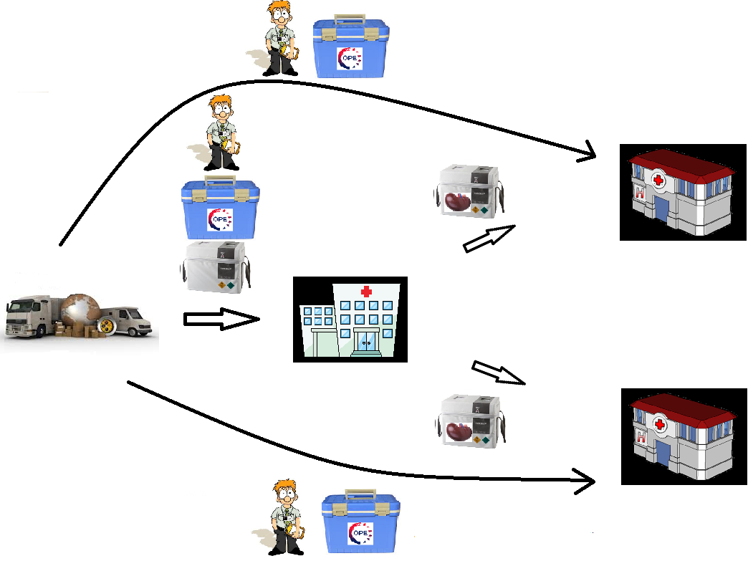
Transplant Technicians
Step by Step
Transplant technician
Cope box (samples)
Transplant technician
Cope box (samples)
Kidney assist (2)
Kidney assist
+ kidney
Recipient hospital
Hub Medical logistics
Donor hospital
Kidney assist
+ kidney
Recipient hospital
Transplant technician
Cope box (samples)

Slide 15
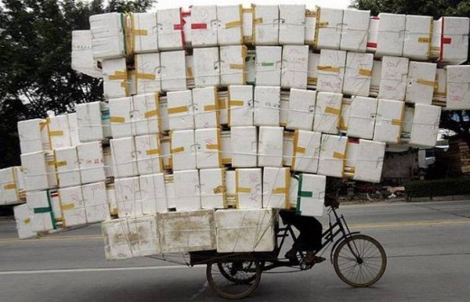
Step by Step procedure
Transportation
Transplant coordinator arranges standard transportation

Slide 16
Step by Step procedure
Recipient
Recipient Transplant Technician:
Contact TC recipient hospital by phone
Inform that patient is included
Transplant coordinator
Inform nephrologist / surgeon that patient is included in trial: informed consent & QoL should be taken

Slide 17

Step by Step procedure
Recipient
Informed consent - deferred consent
Surgeon / Nephrologist / Study nurse
After patient has arrived in the hospital on day of transplantation
Content:
Data collection
Additional blood samples
If patient does not wish to participate, he will receive kidney, but no recipient data will be collected
Dutch, French, German, English
Notes:
Written informed consent will be documented by means of a dated signature from the participant and dated signature from the person who presented and obtained the informed consent. The person who obtains consent must be:
Suitably qualified and capable of providing information about the study;
Capable of answering questions about the study or ensuring that such questions are answered by a suitable qualified individual;
Authorised to do so by the principal investigator.

Slide 18

Step by Step procedure
Recipient
Quality of Life (QoL) questionnaire
Surgeon / Nephrologist / Study nurse
After patient has arrived in the hospital on day of transplantation
EQ-5D-5L
2 pages
Pain, mobility, anxiety, usual activities, self care
Dutch, French, German and English
eCRF

Slide 19
Step by Step procedure
Recipient
Transplantion Procedure
Kidney is removed from kidney assist
Biopsy postreperfusion
Standard care
Transplant Technician
Assisting surgeon
Sampling
eCRF

Slide 20
Step by Step procedure
Follow up
Activity | Pre -Tx | Postoperative |  |  |  |  |  |  | Follow up
 |  | D1 | D2 | D3 | D4 | D5 | D6 | D7 | M3 | M6 | M12
Dialysis requirement |  | X | X | X | X | X | X | X | X | X | X
Graft survival |  | X | X | X | X | X | X | X | X | X | X
Recipient survival |  | X | X | X | X | X | X | X | X | X | X
Serum Creatinine |  | X | X | X | X | X | X | X | X | X | X
24-h creatinine clearance |  |  |  |  |  |  |  |  |  |  | X
Quality of Life (EQ-5D) | X |  |  |  |  |  |  |  | X |  | X
Resource log |  |  |  |  |  |  |  |  |  |  | X

Slide 21
Step by Step procedure
Follow Up
Quality of Life:
3 mo & 1 year post-transplant
Resource Use log:
Given after discharge
Data about GP visits, admissions to (rehabilitation)hospital,…
1 year
eCRF

Slide 22


